Slide 1
Polynuclear hydrocarbons

Slide 2
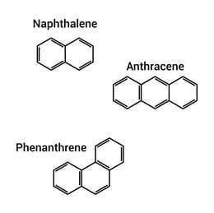
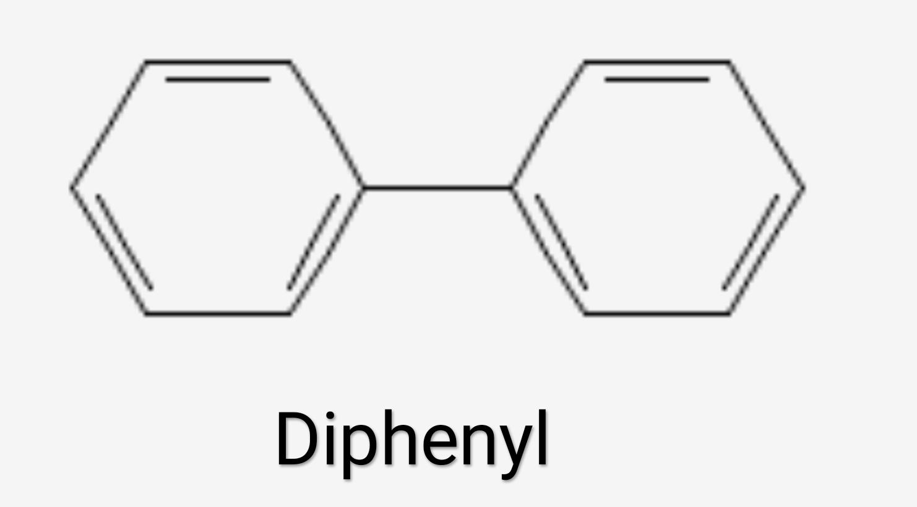
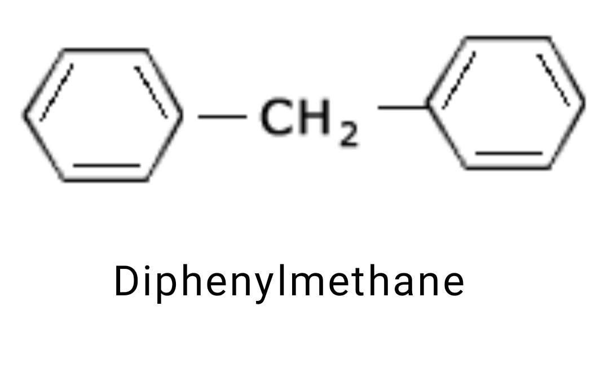
INTRODUCTION
Polynuclear aromatic hydrocarbons are those hydrocarbons which have more than one aromatic ring in their molecules. They are of two types :
(i)Those in which the animatic rings are connected either directly by single bonds or through other carbon atoms. For example
(ii) Those in which the rings are
fused by sharing pairs of ortho carbon atoms. For example

Slide 3
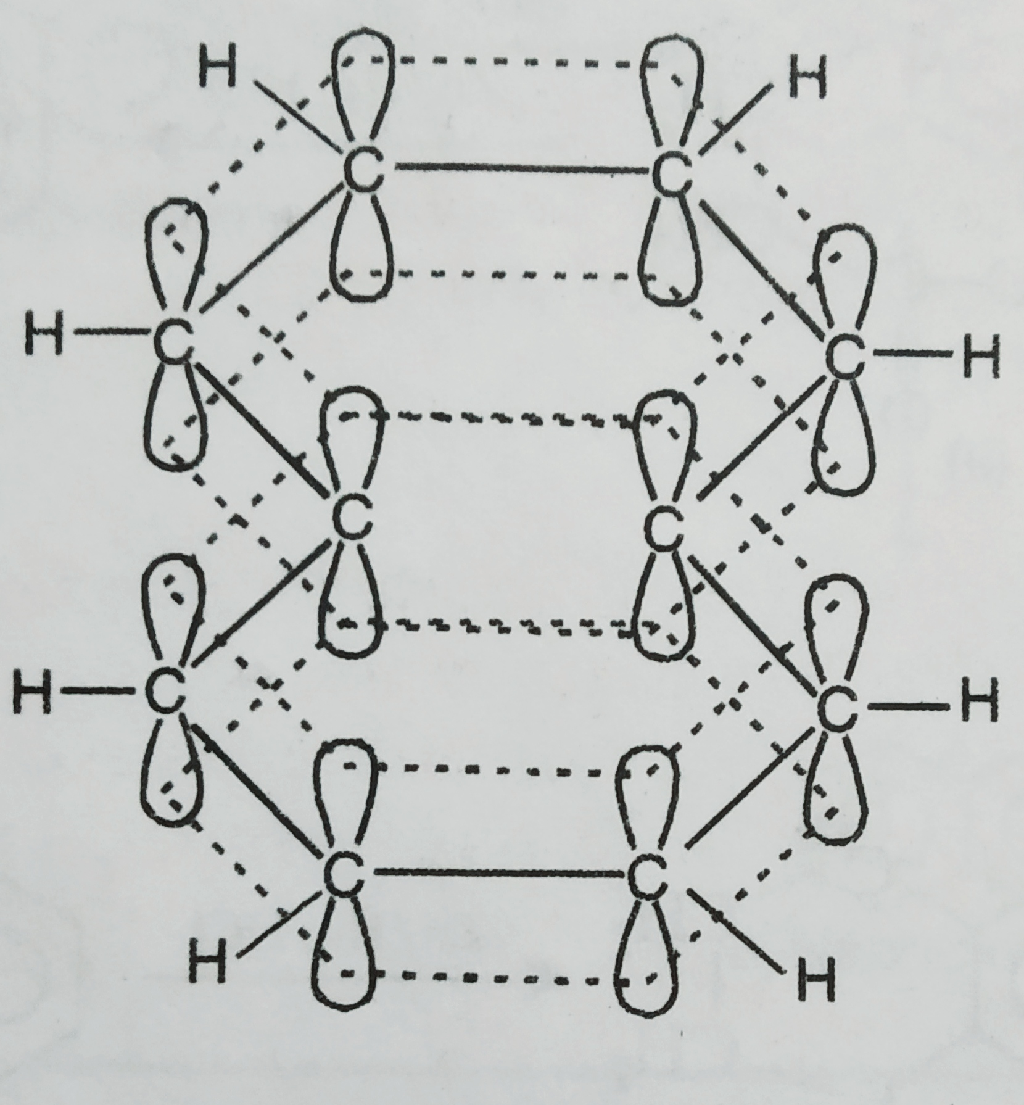
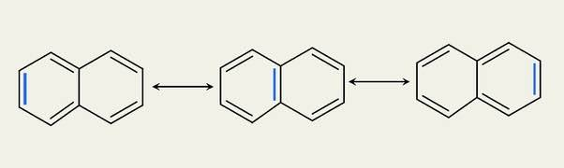
NAPHTHALENE, C10H8
STRUCTURE OF NAPHTHALENE
1 Resonance concept
2 Orbital concept

Slide 4
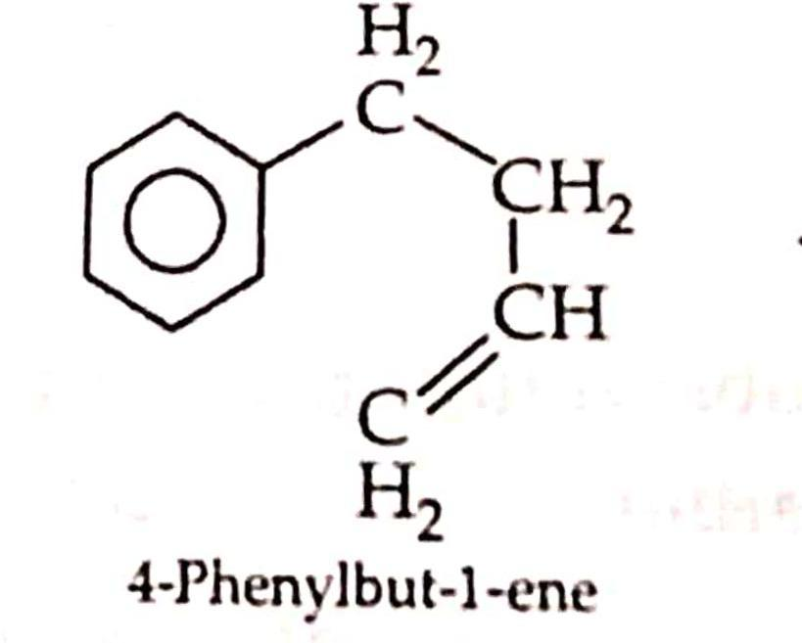
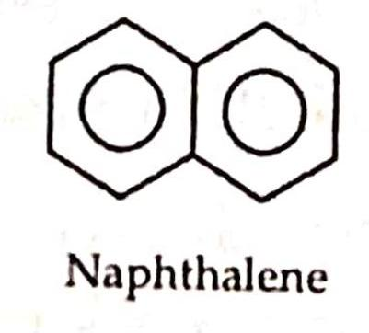
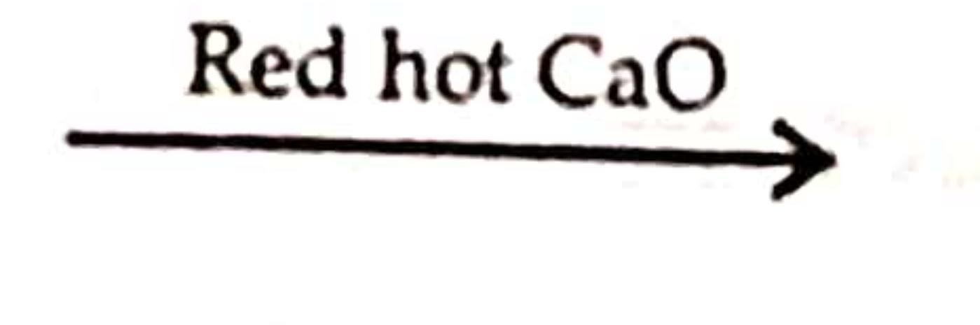
SYNTHESIS OF NAPHTHALENE
Naphthalene is formed by passing 4-phenylbut-1-ene over red hot calcium oxide.

Slide 5
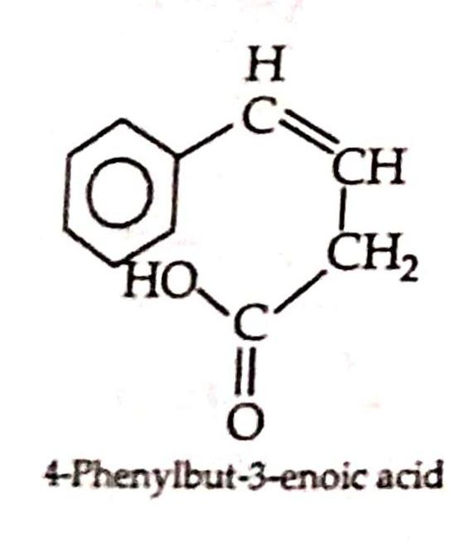
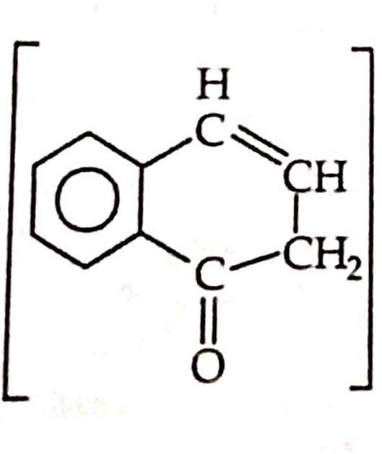
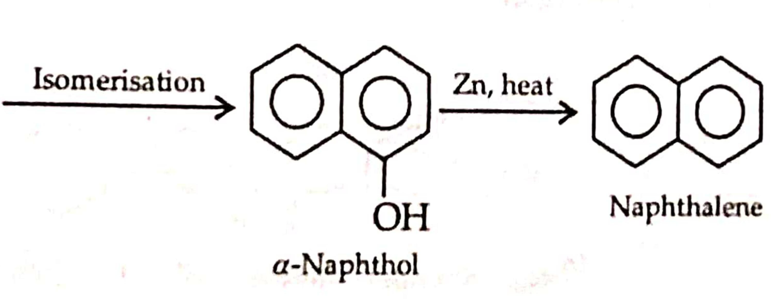
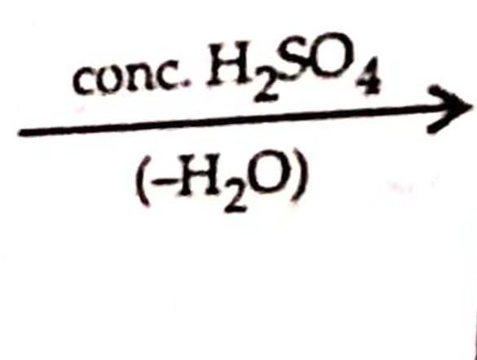
Fittig’s synthesis

Slide 6
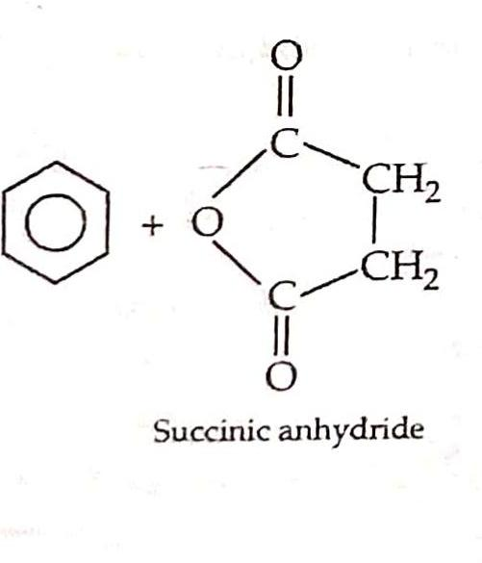
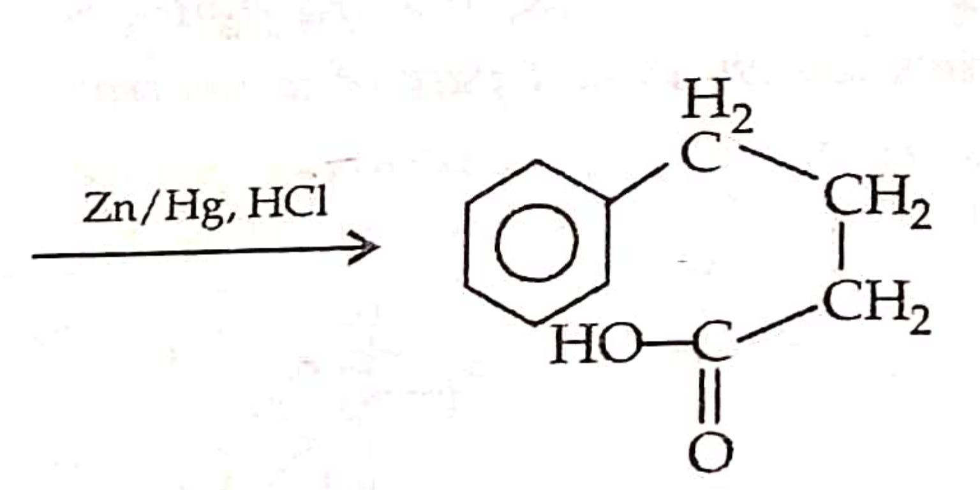
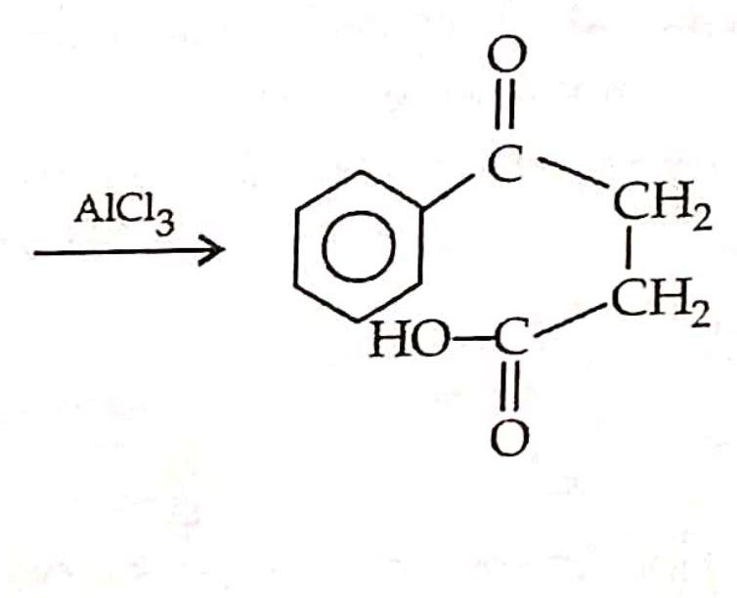
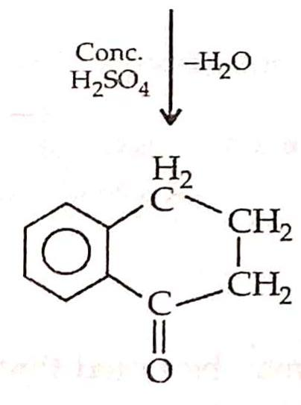
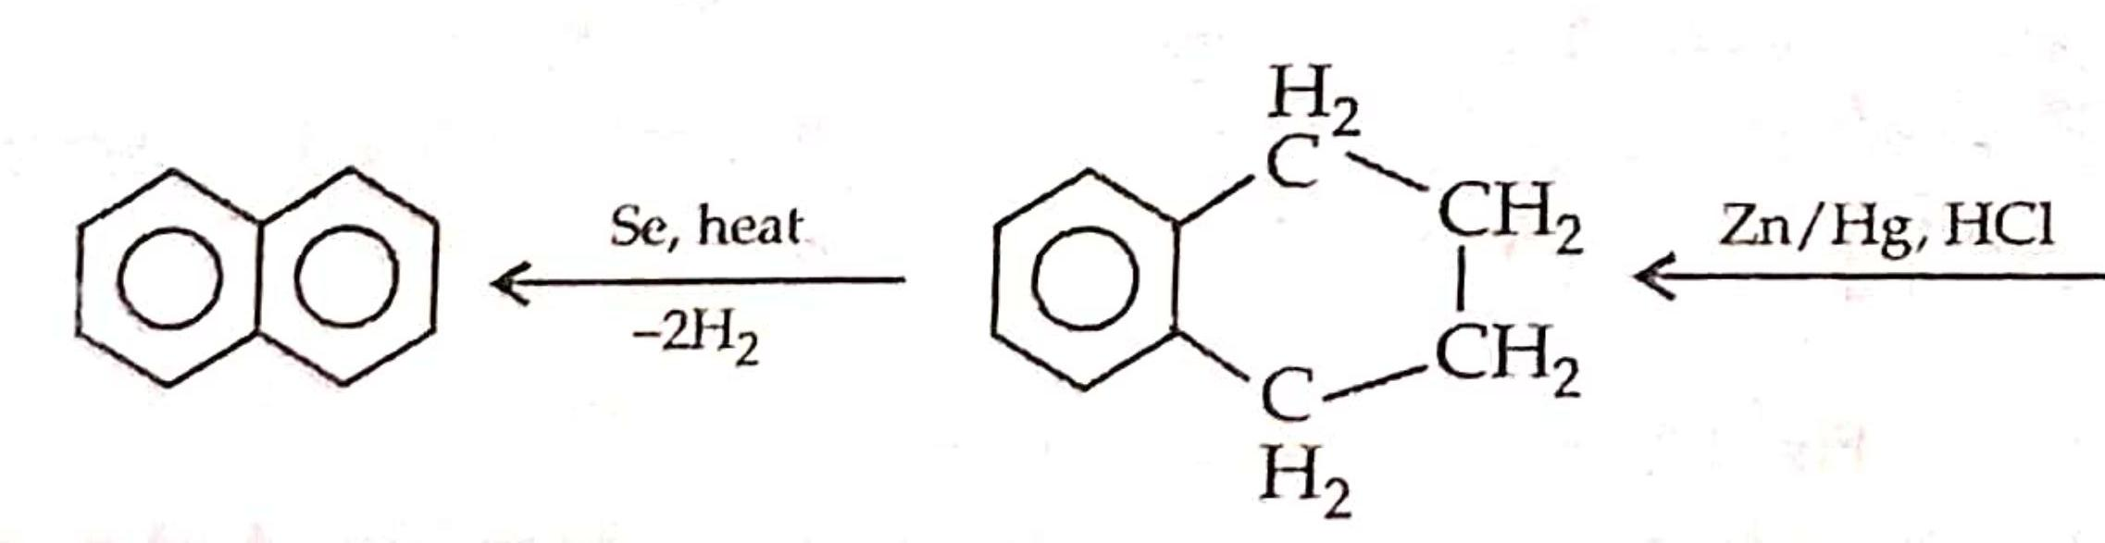
Haworth’s synthesis

Slide 7
PHYSICAL PROPERTIES OF NAPHTHALENE
1. Naphthalene forms coloureless shining plates (m.p. 353 K) having a strong characteristic odour (moth ball odour)
2. It is insoluble in water but soluble in organic solvents
3. It is highly volatile and sublimes readily on heating.

Slide 8
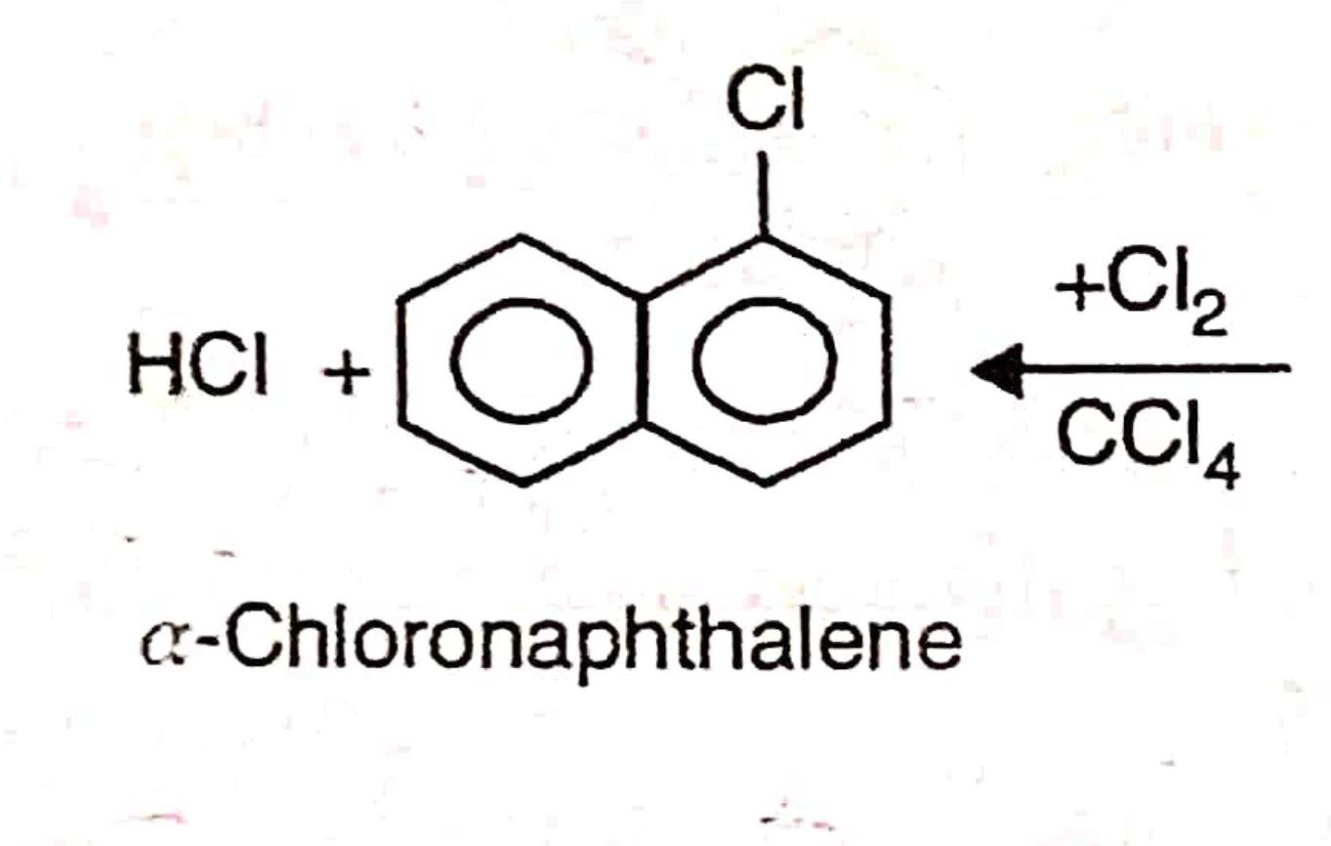
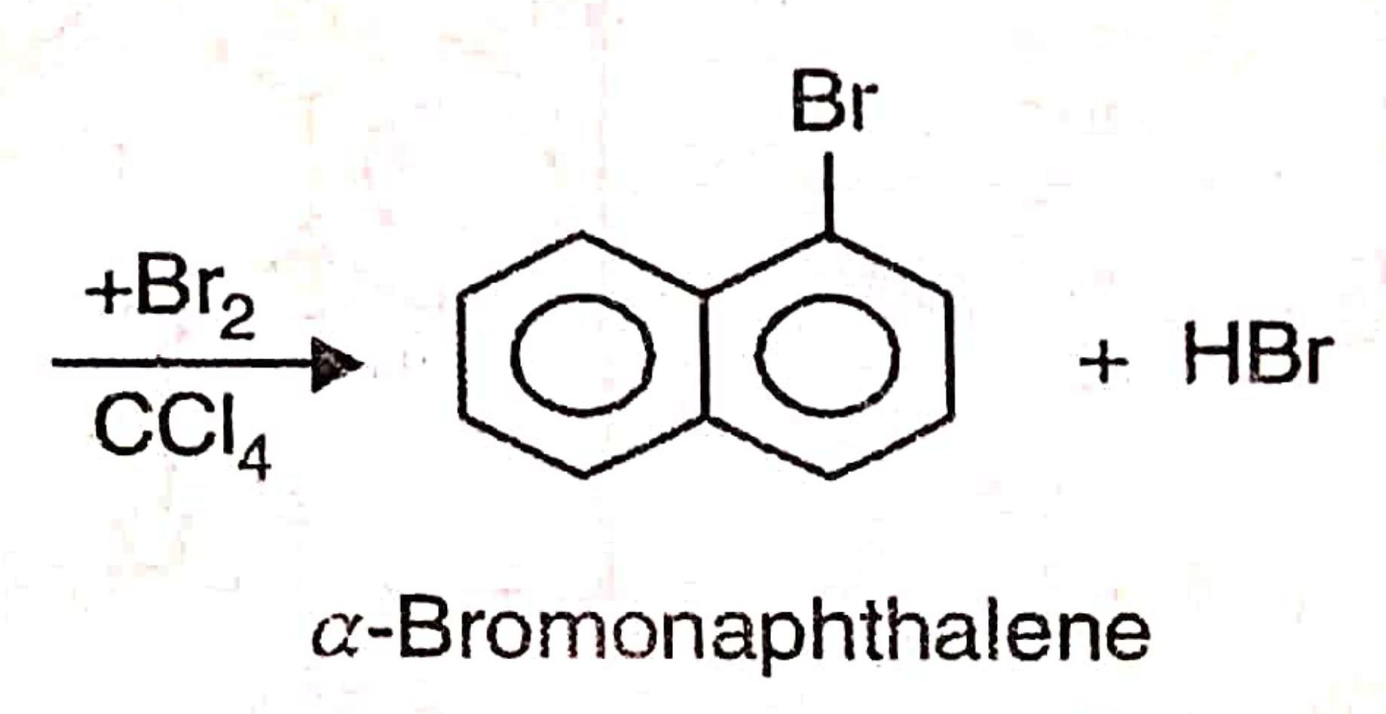
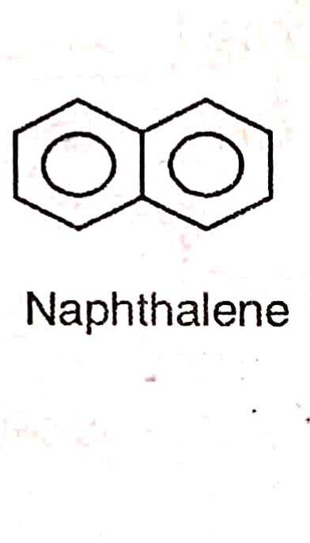
Electrophilic Substitution Reaction
1 Halogenation

Slide 9
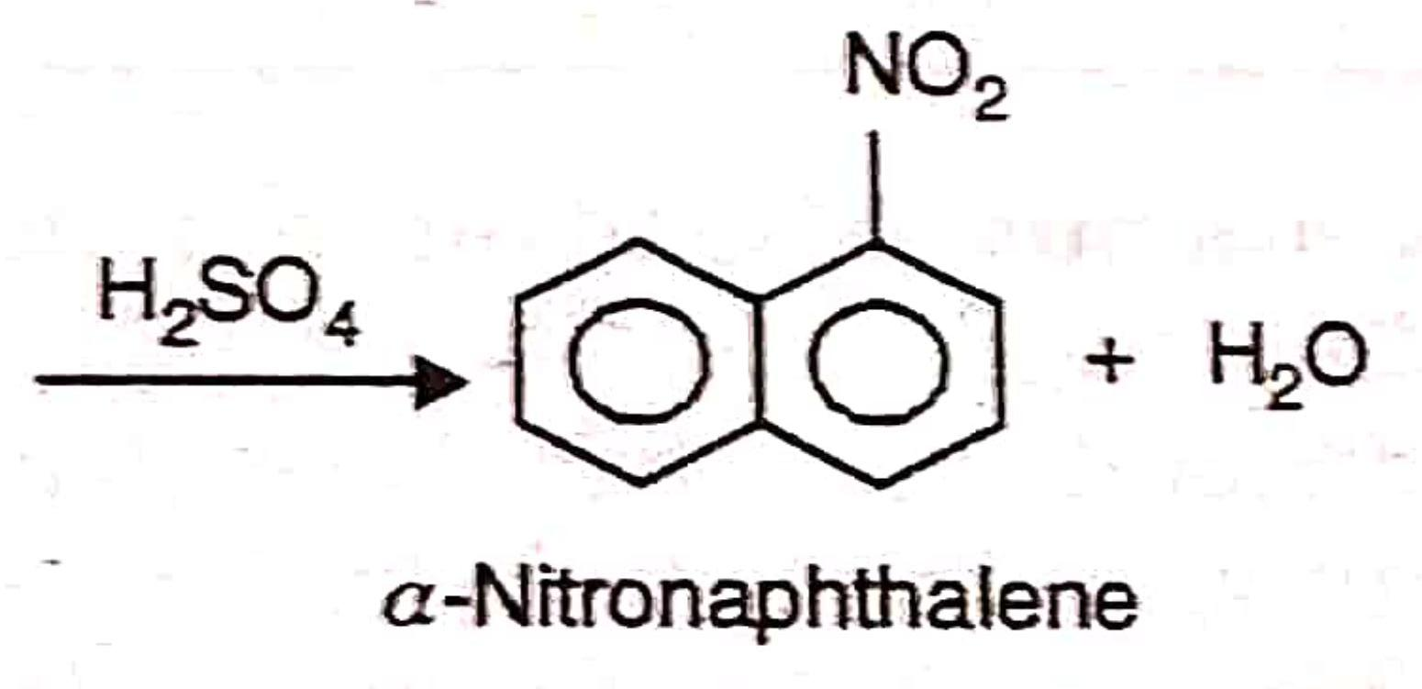
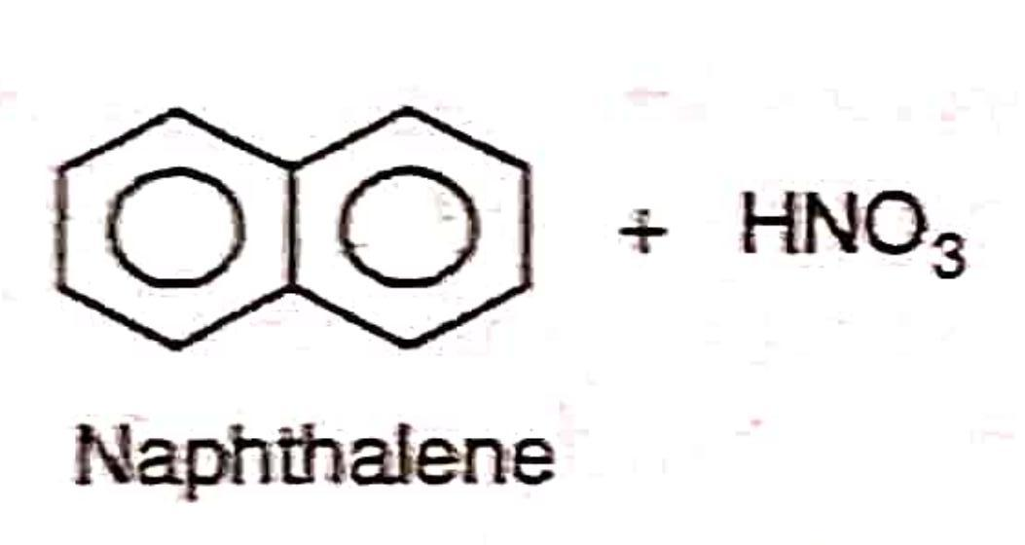
2 Nitration

Slide 10
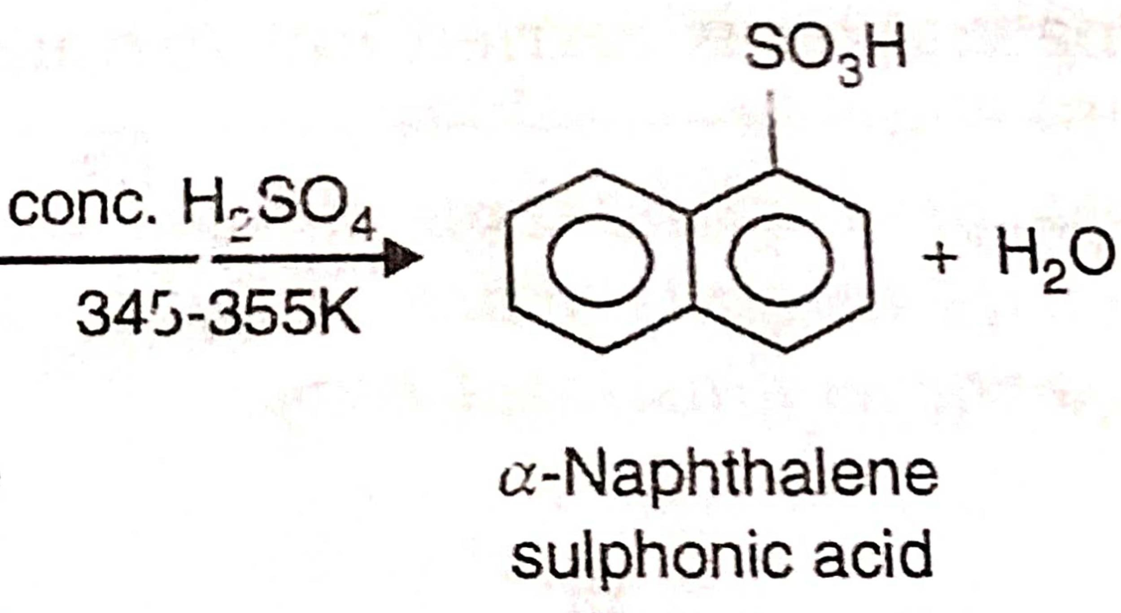
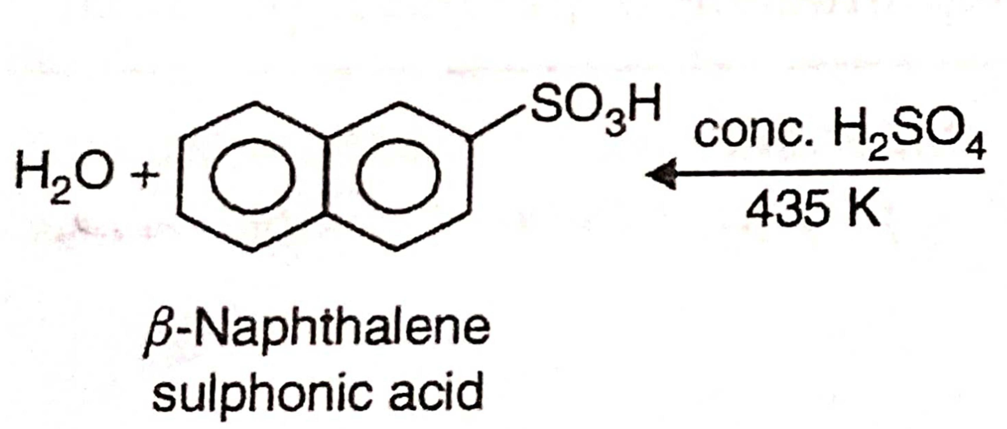
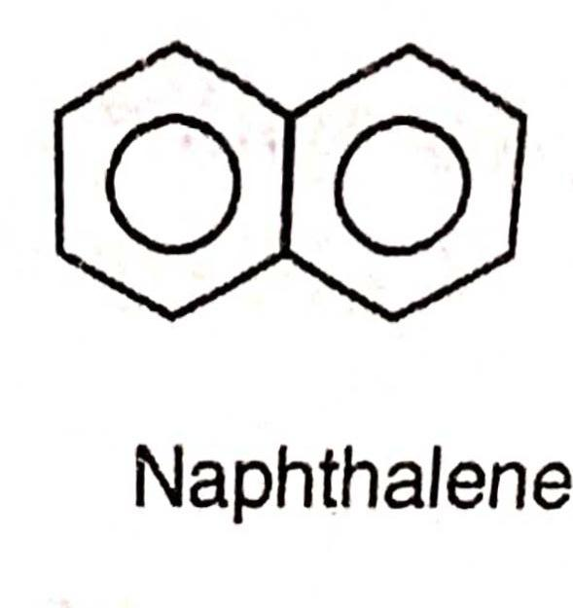
3. Sulphonation

Slide 11
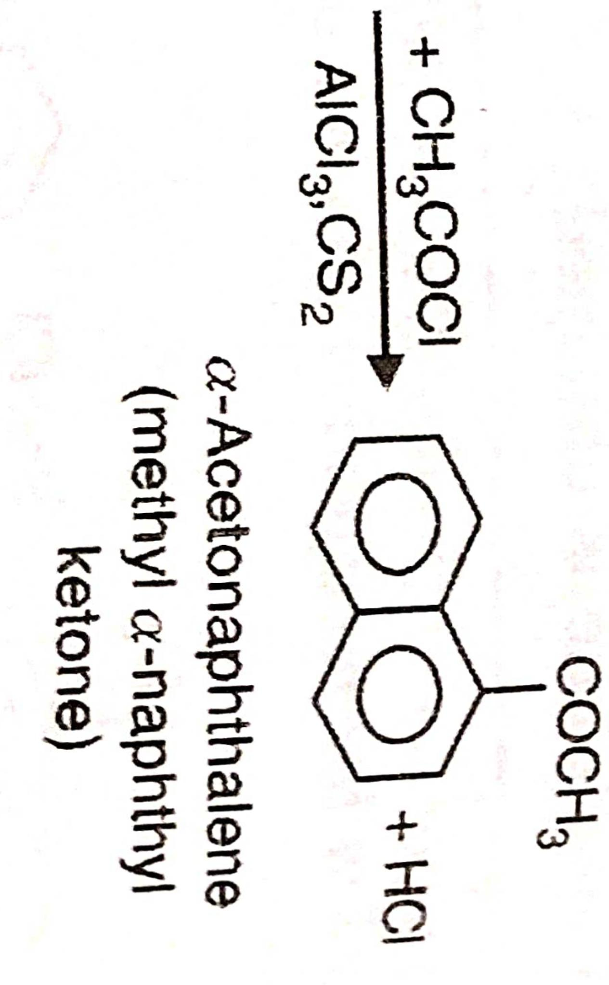
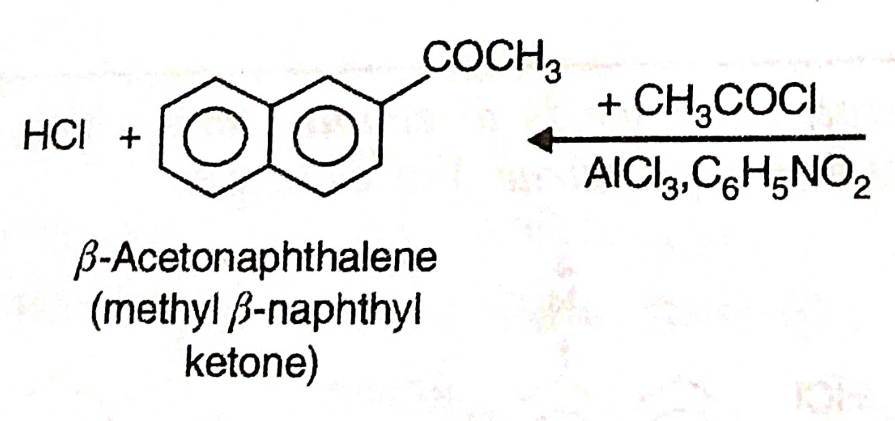
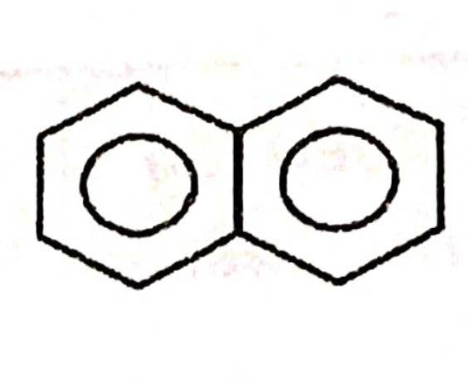
4. Friedel-Crafts reaction

Slide 12
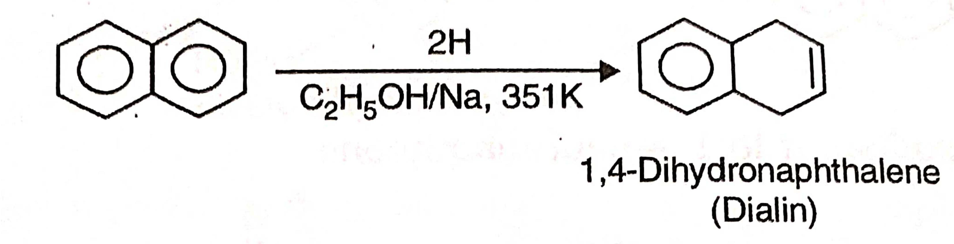
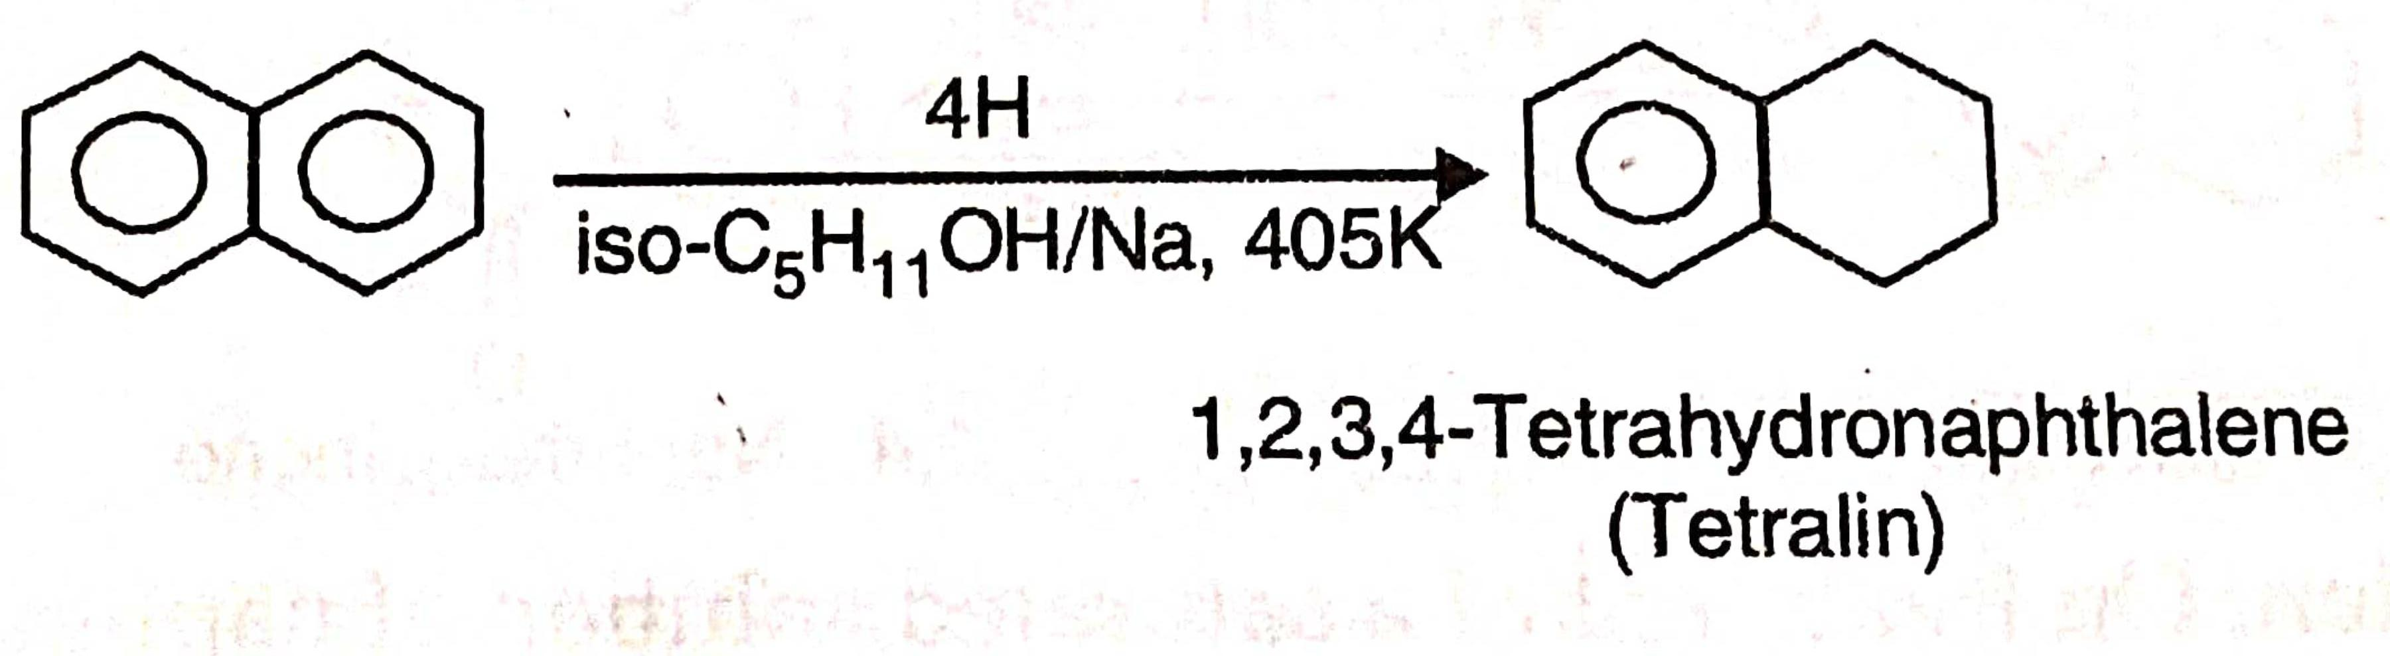
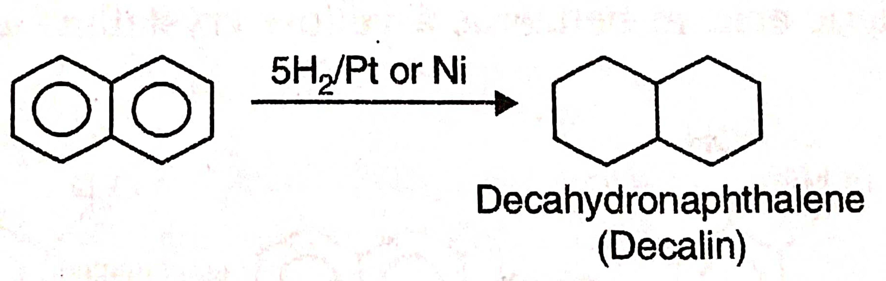
Addition Reaction
1 Reduction

Slide 13
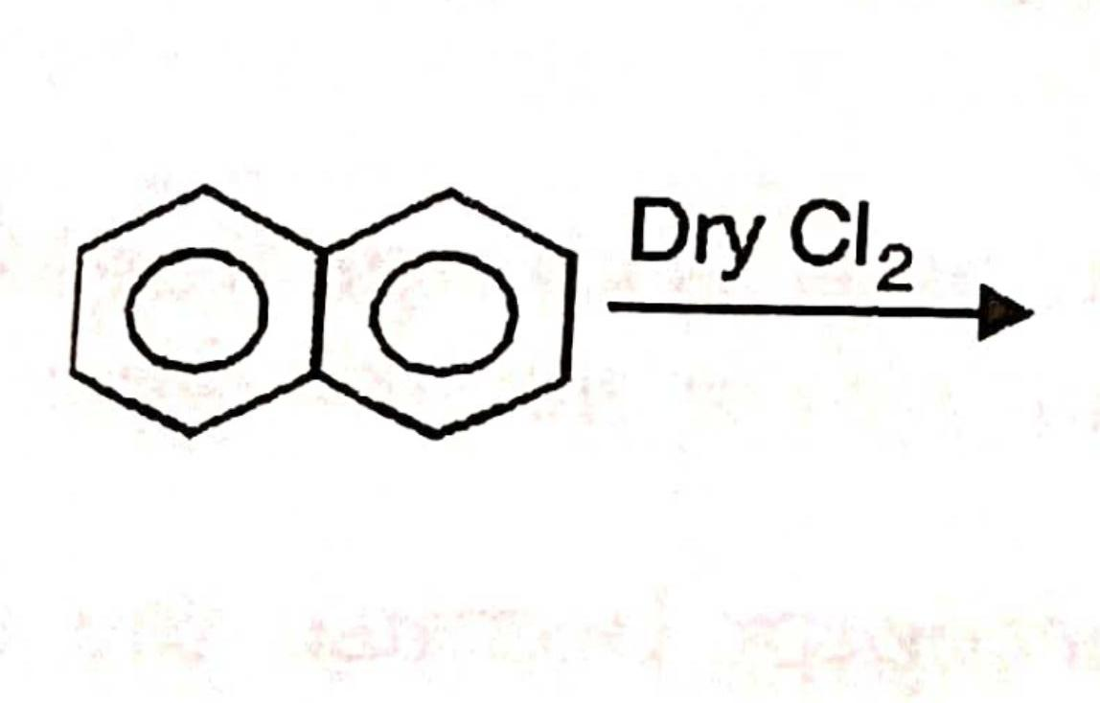
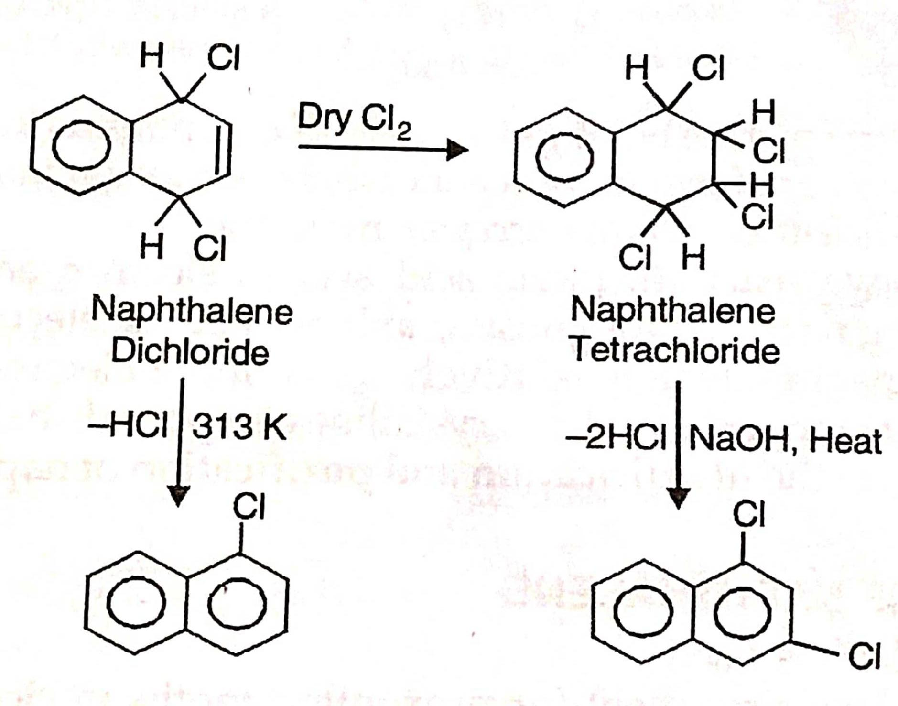
2. Addition of halogens.

Slide 14
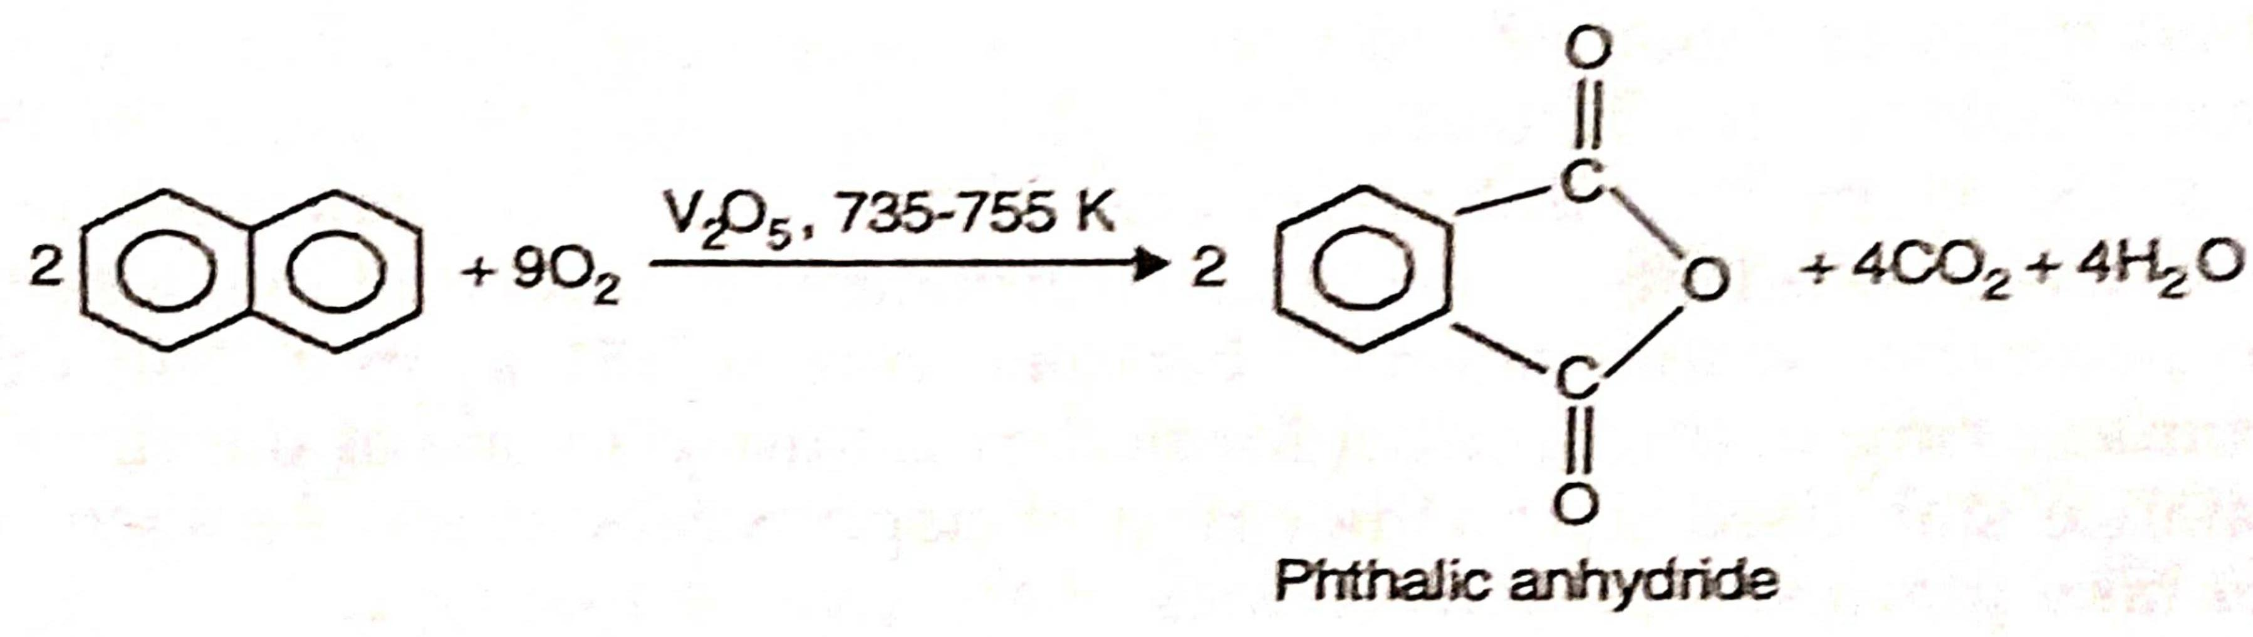
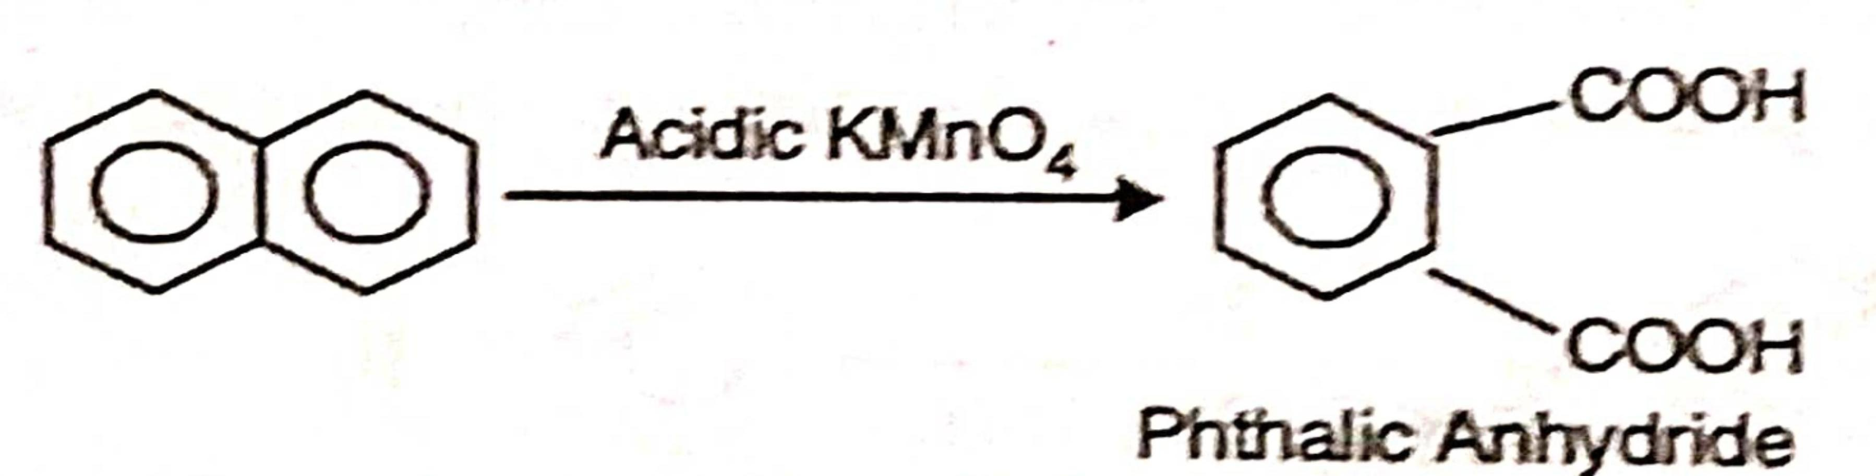
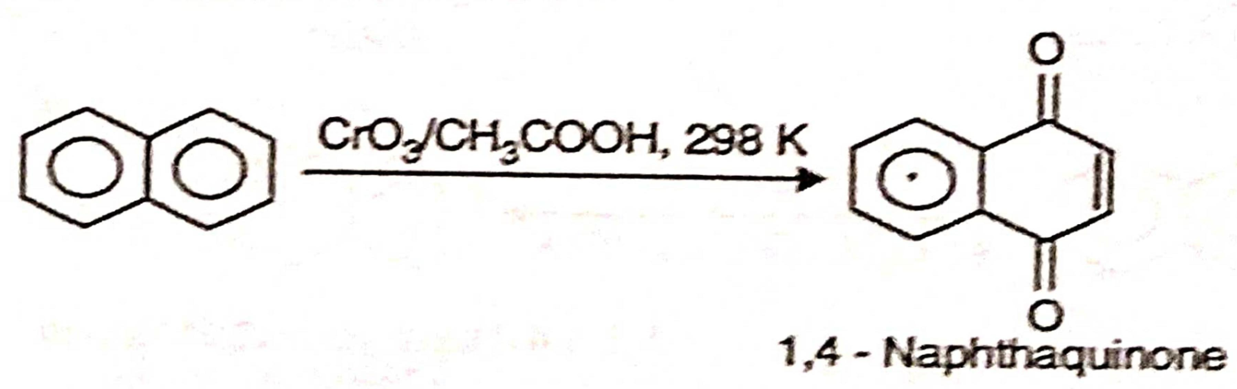
Other Reaction
1 Oxidation

Slide 15
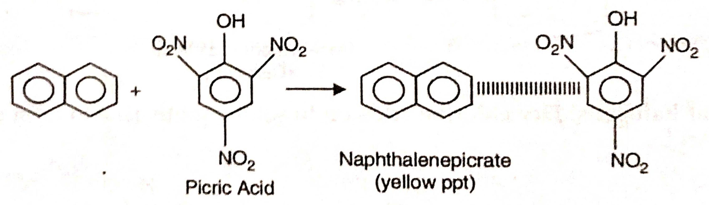
2. Picrate formation

Slide 16
USES OF NAPHTHALENE
Naphthalene is used :
(1) as an insect-repellent for preventing moths in clothes;
(2) in the manufacture of phthalic anhydride, antharanilic acid and azo dyes, and
(3) in the manufacture of tetralin and decalin which are used as industrial solvents

Slide 17
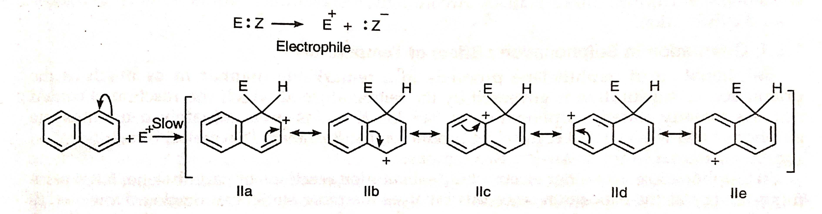
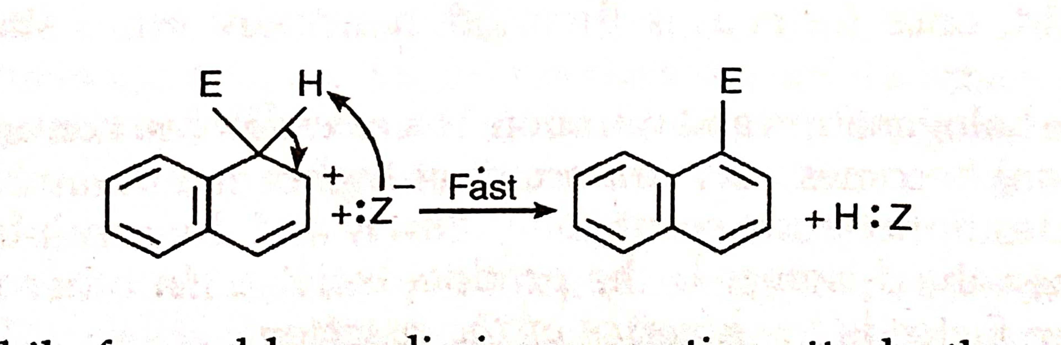
MECHANISM OF SUBSTITUTION IN NAPHTHALENE

Slide 18
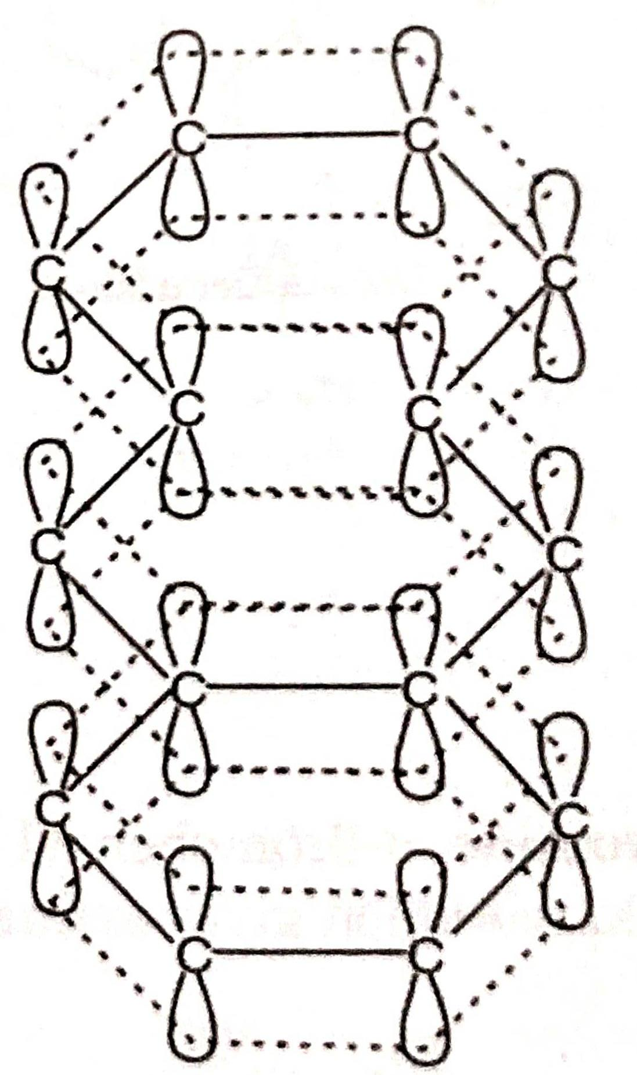
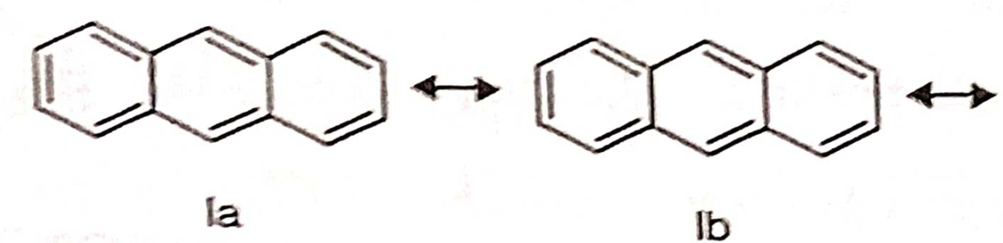
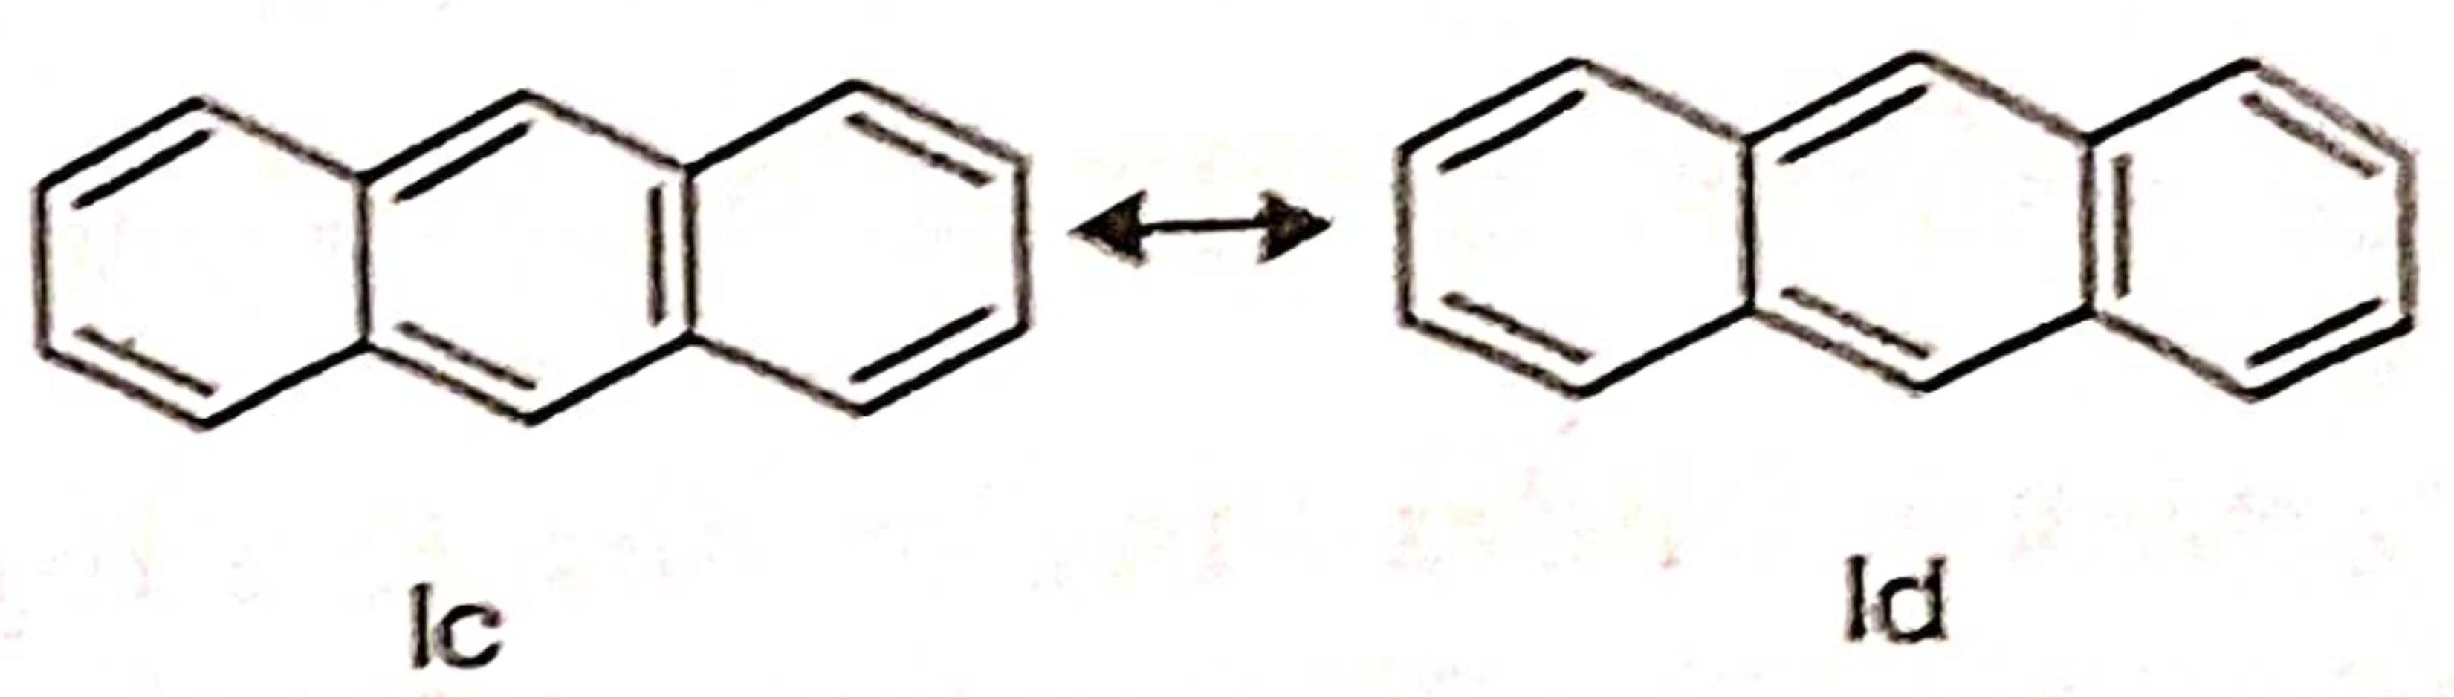
ANTHRACENE, C14H10
Structure of ANTHRACENE
1 Resonance concept
2 Orbital concept

Slide 19
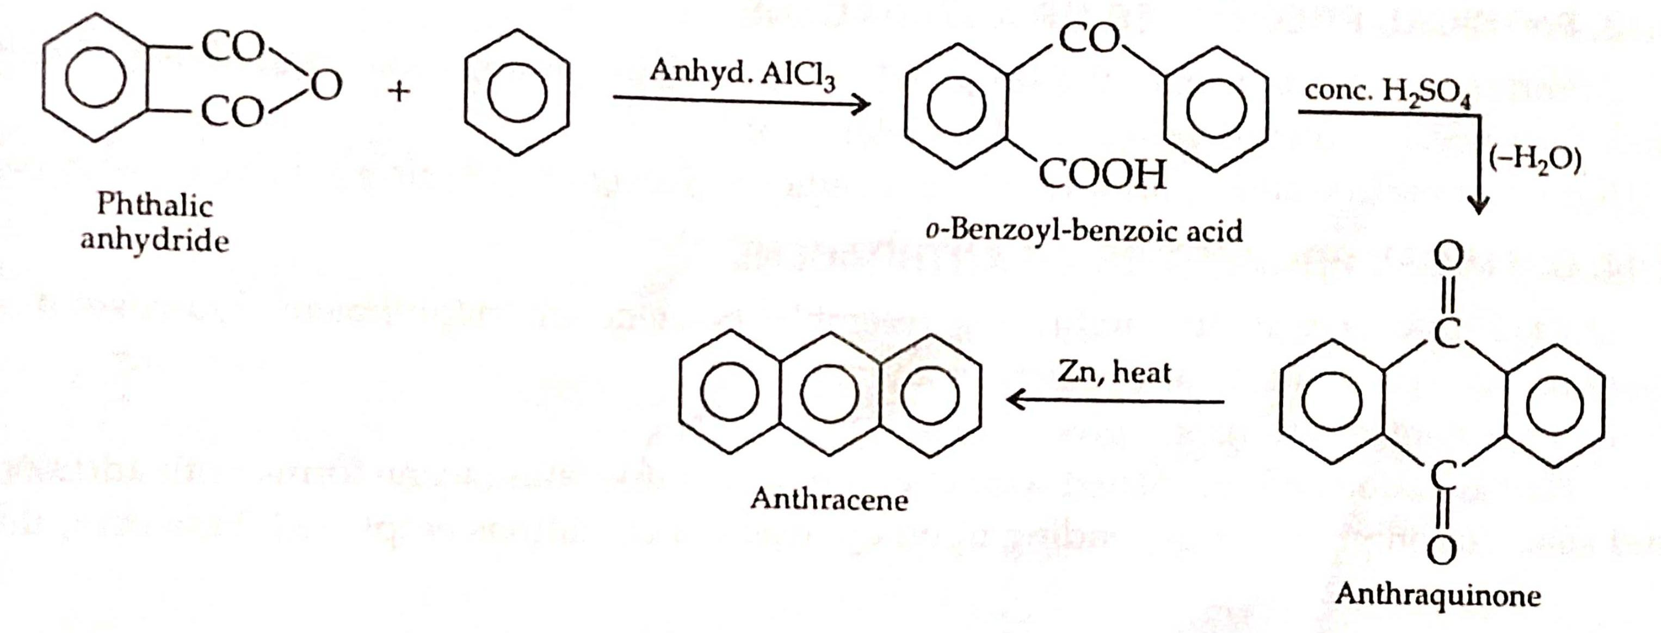
SYNTHESIS OF ANTHRACENE
1 Friedel-Crafts acylation with phthalic anhydride

Slide 20
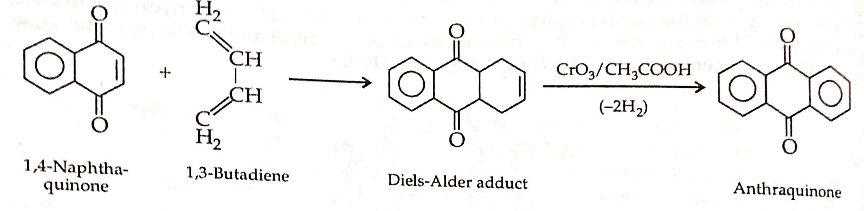
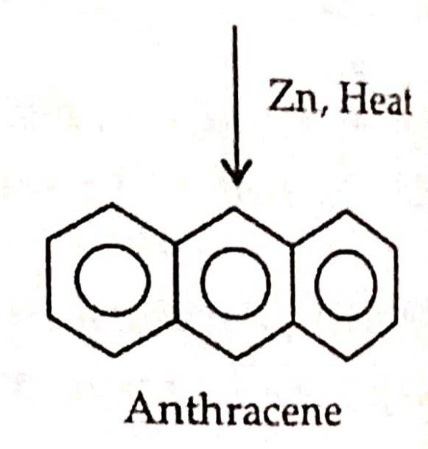
2 Diel’s-Alder reaction

Slide 21
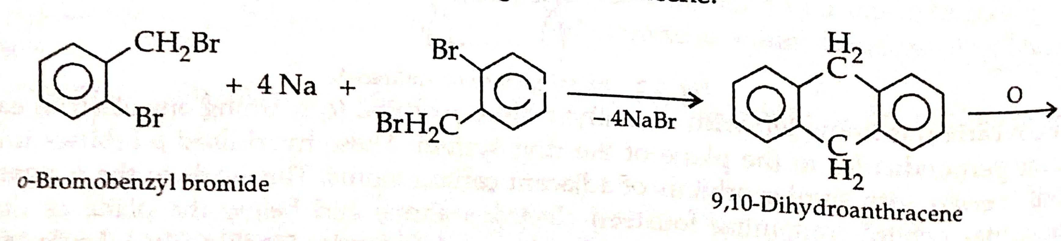
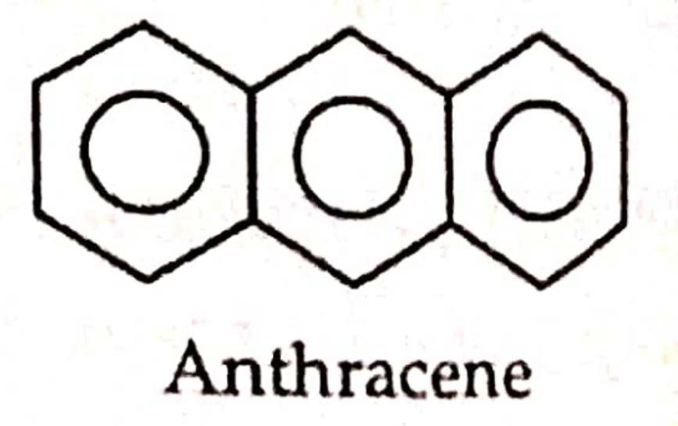
3. o-Bromobenzy bromide

Slide 22
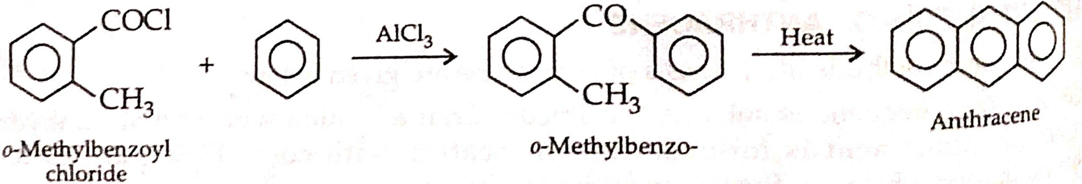
4. Elb’s reaction

Slide 23
PHYSICAL PROPERTIES OF ANTHRACENE
Anthracene is a colourless solid (m.p. 591 K). It exists as shining flakes and shows strong blue fluorescence when exposed to ultraviolet light.
It is insoluble in water, sparingly soluble in ether and alcohol and fairly soluble in benzene.

Slide 24
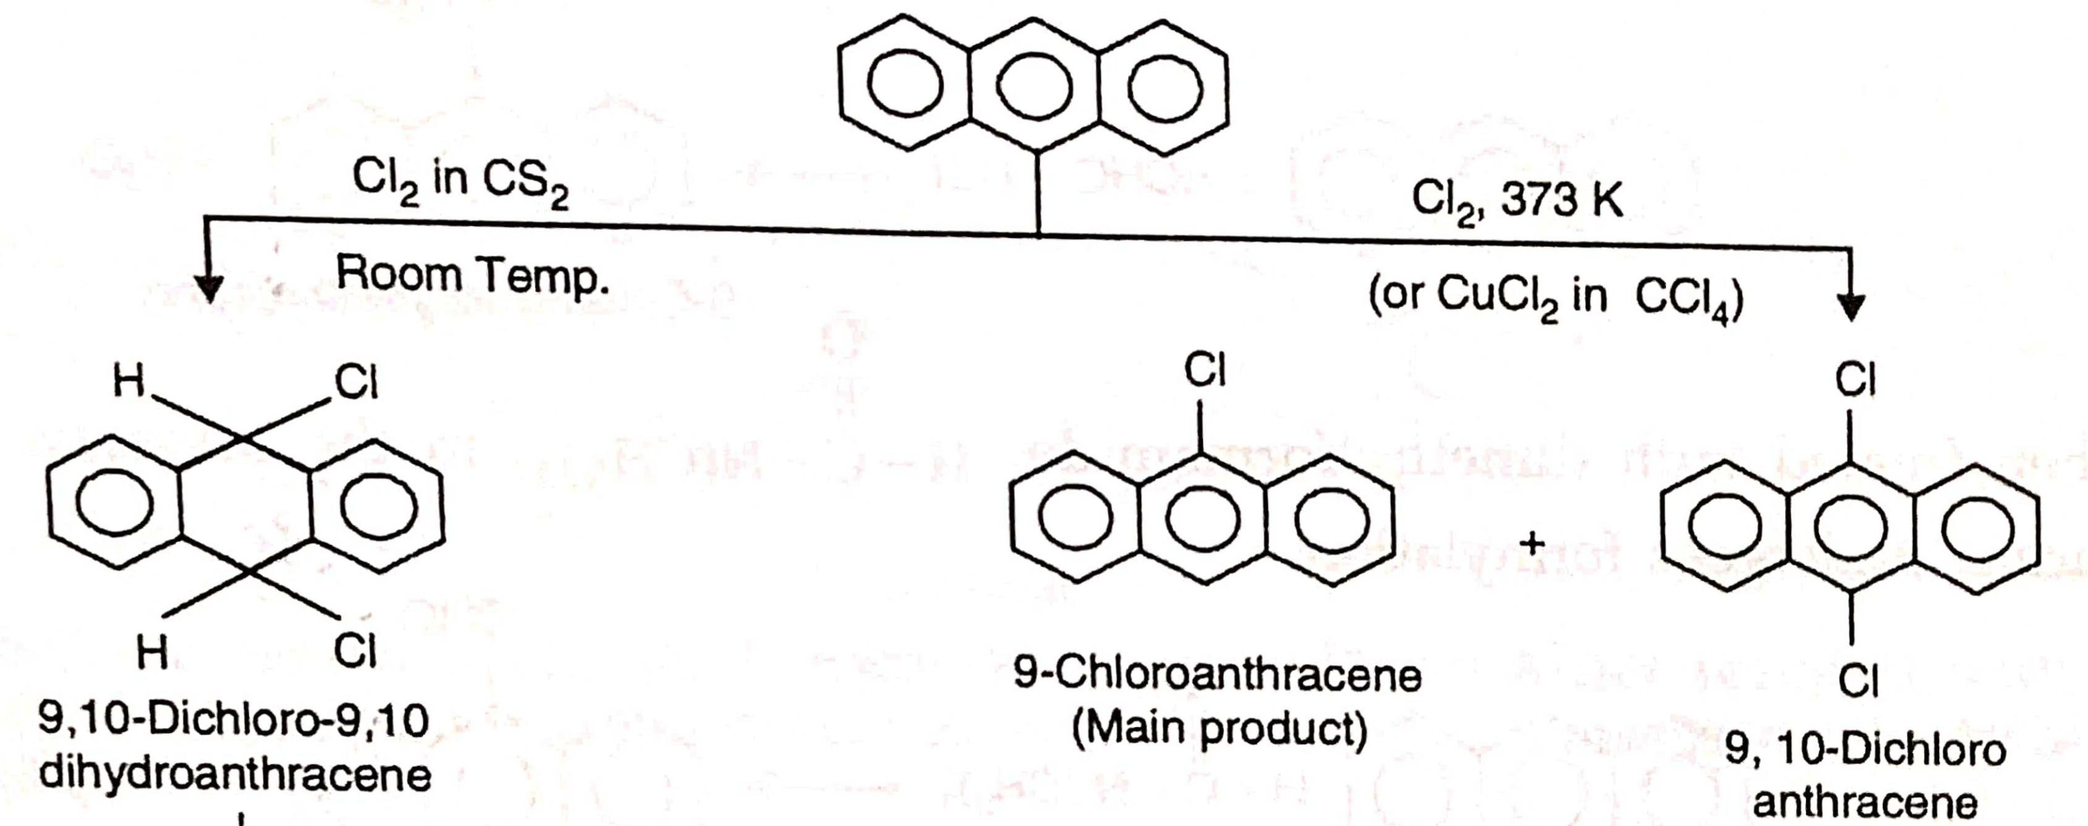
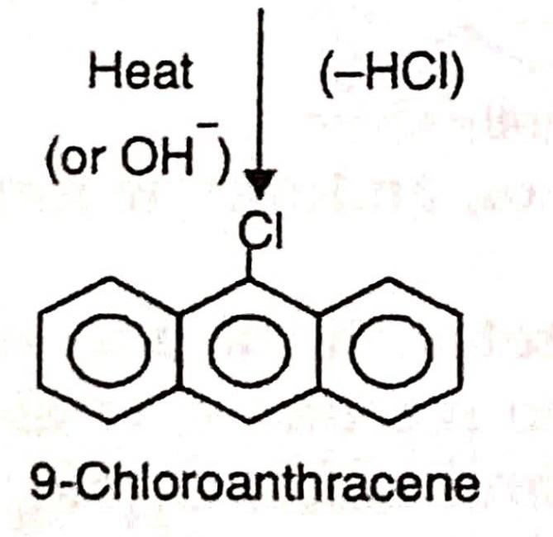
Chemical properties of ANTHRACENE
1. Halogenation

Slide 25

2. Nitration

Slide 26

3. Sulphonation

Slide 27

4. Friedel-Craft‘s acylation

Slide 28


5. Chloromethylation and formylation.

Slide 29

6. Reduction

Slide 30


7. Oxidation

Slide 31

8. Dimerisation

Slide 32

9. Diel’s-Alder reaction

Slide 33


MECHANISM OF SUBSTITUTION AND ADDITION REACTION OF ANTHRACENE
1 Mechanism of substitutio
2 Mechanism of addition

Slide 34
Uses Of ANTHRACENE
Anthracene is mainly used for the preparation of anthraquinone and certain dyes

Slide 35


PHENANTHRENE, C14H10
Structure of Phenanthrene
1 Resonance concept
2 Orbital Concept

Slide 36

SYNTHESIS OF PHENANTHRENE
1 Pschorr’s synthesis

Slide 37

2. Haworth’s synthesis

Slide 38
PHYSICAL PROPERTIES OF PHENANTHRENE
1. Phenanthrene is a colourless solid (m.p. 372 K)
2. It is insoluble in water but soluble in organic solvents such as benzene.
3. Its solution is benzene shows blue flourescence.

Slide 39

CHEMICAL PROPERTIES OF THE PHENANTHRENE
1 Addition of halogens

Slide 40

2. Reduction

Slide 41

3. Electrophilic substitution reaction

Slide 42


4. Oxidation
5. Ozonolysis

Slide 43

MECHANISM OF SUBSTITUTION AND ADDITION REACTION OF PHENANTHRENE

Slide 44
Thanks

